Slide 1
Estimating transmission parameters from household outbreak data
Pierre Nouvellet
(and Simon Cauchemez)
MRC Centre for Outbreak Analysis and Modelling, DIDE
Imperial College London

Slide 2
Context
Emerging disease outbreaks:
Hong Kong: SARS, 2001;
Anywhere in the world: H1N1 pandemic influenza, 2009.
Questions:
What are the key epidemiological features of the pathogen?
What kind of studies to reduce knowledge gap?

Slide 3
Overview
What is it that we want to estimate and why?
What kind of data?
What are the key statistical challenges / key biases we face to extract information from the data? How can we tackle them?
What can learn from household studies?

Slide 4
What is it that we want to estimate and why?

Slide 5
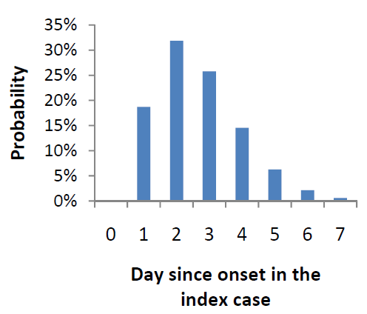
Transmission potential and timing of transmission
Policy question
What we need to know
Transmission potential:
Is the epidemic going to take off? Is it under control?
What proportion of the population will be infected?
Reproduction number R - mean number of cases generated by a case.
Y=1
t=1
Y=2
t=2
Y=4
t=3
Y=8
t=4
Timing of transmission:
How long should cases be isolated to reduce transmission?
When will the epidemic peak?
What’s the impact of delays in treatment deliveries on efficacy of interventions?
Generation time – time lag between infection of a case and infection of the people they infect.
Serial interval – time from onset to onset.

Slide 6
Heterogeneities in transmission
Policy question
What we need to know
Who should be targeted?
See debate on best way to protect elderly people against seasonal influenza.
Measures of heterogeneities at individual level - e.g. age-specific susceptibility or infectivity profiles
Contribution of children in overall epidemic
Impact of interventions targeting places:
Impact of school closure on influenza spread?
Impact of household prophylaxis, i.e. treating household contacts of cases?
Estimates of transmission rates in the different settings (schools, households, community…)

Slide 7
What kind of data can we use to estimate transmission characteristics of a pathogen?

Slide 8
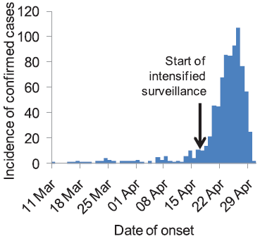
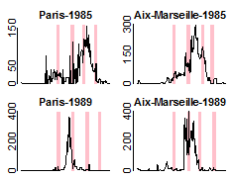
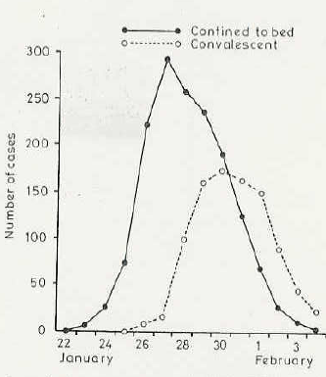
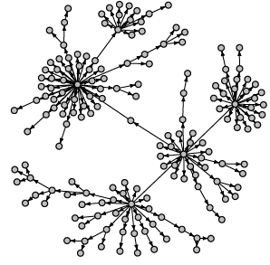
Sentinel surveillance
Data on confirmed cases
Follow-up of micro-epidemics in households
Outbreak investigations in schools
Contact tracing data
A “laboratory” within which many of the key measures of transmission can be studied.

Slide 9
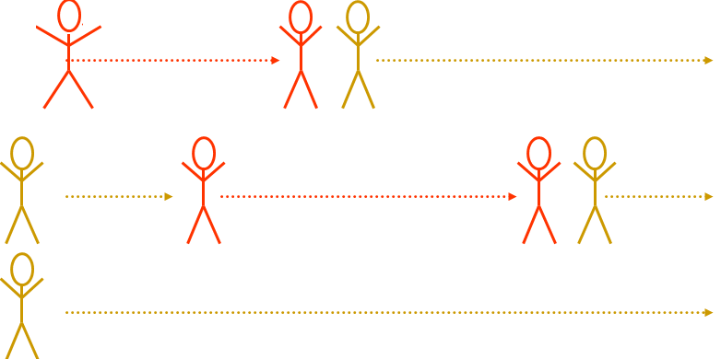
Household studies
Follow-up of symptoms in households for 15 days after onset in the index case.
[Cauchemez et al, Stat Med, 2004]

Slide 10
1- Standardized measure of transmissibility
Index case:
Secondary Attack Rate (SAR)=
% of household contacts who get infected
Household contacts:
Outbreak investigations (e.g. schools) often suffer from important selection bias:
We tend to investigate outbreaks that are atypically large;
Attack rates from schools etc may be misleading (overestimates).
Household studies do not suffer from that kind of bias.

Slide 11
2- Age-specific susceptibility
Index case:
child
Household contacts:
Are children more at risk of infection than adults?
adult
During the H1N1 pandemic, surveillance data on confirmed cases were also used to derive age-specific susceptibility profiles;
But surveillance data affected by reporting bias:
Children often more likely to be reported;
Investigations often focus on schools…

Slide 12
3- Age-specific infectivity
Are children more infectious than adults?
Index case:
Household contacts:

Slide 13
4- Serial intervals
Index case:
Household contacts:
Serial Interval
Contact tracing data
Difficult to estimate serial intervals from other datasets;
E.g. contact tracing:
Incomplete tracing;
Multiple sources of infection;
Long serial intervals may be more difficult to observe than short ones.

Slide 14
5- How do transmission rates change with population size?
Model 1: p-to-p transmission rate does not change with household size
β
β
β
β
β
β
Model 2: p-to-p transmission rate decreases with household size
People partition their time between household members
β
β/2
β/3
β/3
β/2
β/3

Slide 15
An illustration: US case report forms during the H1N1 pandemic
In the early phase of the pandemic (April 29th-May 25th 2009), state health departments were asked to report all probable and confirmed cases to CDC:
Persons meeting the definition were contacted by staff in state and local health departments;
Interviewed by phone or in person using standardized case report form;
Case report forms were faxed to CDC.
Index case: person who was the focus of the report.
Case report form:
Demographic and clinical information on the index case;
Section dedicated to household members:
Age;
Symptoms within 7 days (before or after) of symptom onset in index case.
[Cauchemez et al, NEJM, 2009]

Slide 16
US case report forms (2)
938 case report forms received by CDC:
62% are less than19 yr.
Median age: 15 yrs.
488 (52%) from 6 states: Arizona, Connecticut, Pennsylvania, Texas and Delaware.
65 (7%) hospitalized.

Slide 17
Estimating transmission characteristics
Analysis restricted to households:
of the most common size (2 to 6);
where the index case is the first case;
with complete information on symptoms and age.
Assumptions:
Household contacts with Acute Respiratory Illness have flu;
No asymptomatic case.
216 households
600 household contacts

Slide 18
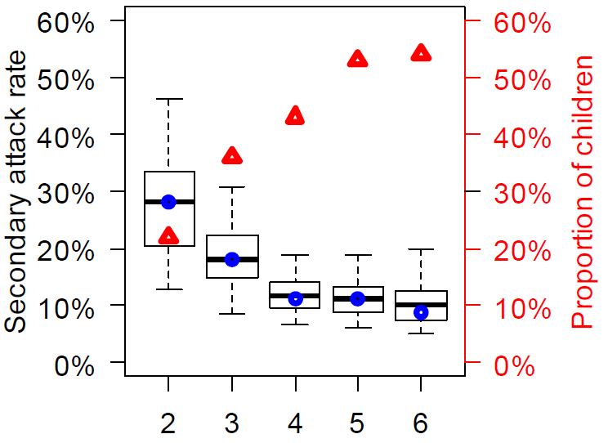
Secondary attack rates
Among the 600 household contacts, 78 (13%) developed ARI.
Age
Household size

Slide 19
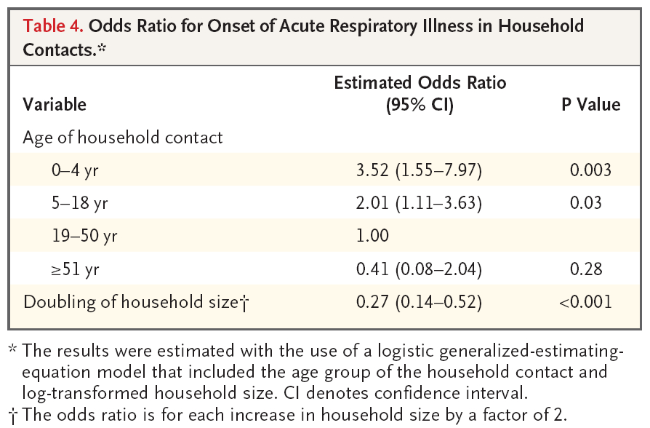
Simple model: a logistic regression
If we assume that all secondary cases were infected by the index case: we can use a simple logistic regression to investigate risk factors (e.g. age of contact or index case, symptoms of index case etc…)

Slide 20
But different routes of infection are possible…
Community case?
[i.e. infected outside the household]
Community case?
Onset in case 1
Onset in case 2
Onset in case 3
Tertiary case? [i.e. infected by a household case that is not the index case]
Time

Slide 21
Potential biases…
If we assume that infection was always due to the index case, we are likely
To overestimate the generation time;
Obtain biased estimates of age-specific infectivity profiles etc...
If we do not account for the truncated nature of the data,
We may potentially underestimate the generation time.
End of follow-up
Onset in case 1
Onset in case 2
Onset in case 3
Time

Slide 22
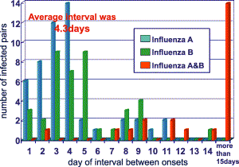
Community & tertiary cases: very concrete problems
Seasonal influenza [Hirotsu, Options V, 2004]
When do you start assuming a contact was infected in community?
1957 pandemic
[Jordan et al, Am J Hyg, 1958]
Tertiary cases?

Slide 23
Tertiary cases: not necessarily a marginal issue
 |  |  | Number of household contacts diagnosed with ARI
 |  |  |  | 0 |  | 1 |  | 2 |  | 3 |  | 4 |  | 5
Household size |  | 2 |  | 53 |  | 49
 |  | 3 |  | 28 |  | 24 |  | 23
 |  | 4 |  | 31 |  | 22 |  | 33 |  | 18
 |  | 5 |  | 11 |  | 11 |  | 10 |  | 7 |  | 4
≥1 secondary cases
≥2 secondary cases
47% of households with ≥1 secondary cases have ≥2 secondary cases
[Cauchemez et al, Stat Med, 2004]

Slide 24
Questions
Q1: How do we build a transmission model that can deal with:
Community cases;
Tertiary cases;
Truncation of the data (i.e. early end of follow-up)?
Q2: How do we fit that model to the data & estimate transmission parameters?
Likelihood-based inference:
Need to write down the likelihood function P(data|parameters)
Maximum-likelihood (frequentist statistics):
Find the set of parameters that maximizes the probability to observe what was effectively observed, i.e. the data.
Bayesian statistics:
Markov chain Monte Carlo sampling (MCMC).

Slide 25
Building a transmission model
Day 0
Day 1
Day 7
Modelling onset in household contacts:
From day 1 to day 7;
Conditional on what is observed on day 0.
Symptom onset in index

Slide 26
Model for household & community transmission
Assumption 1: Infectivity profile assumed to have a parametric form (e.g. log-Normal). Mean and variance estimated.
Assumption 2: Constant risk from community.
Risk due to subject 1
Risk due to subject 2
Risk of onset
Time
Onset in subject 1
Onset in subject 2
Onset in subject 3

Slide 27
Transmission rates in and out of the household
Risk of symptoms onset on day d in subject 3:
Risk λ_{1→3} due to subject 1
Risk λ_{2→3} due to subject 2
Risk of onset
Community risk α
Time
Onset in subject 1
Onset in subject 2
Onset in subject 3

Slide 28
Transmission rates within the household
How does the transmission rate between 2 household members i & j depends on their individual characteristics?
i
j
Simplest model
Serial interval
Risk of onset
Time
Onset in subject 1
Onset in subject 3

Slide 29
Transmission rates within the household
How does the transmission rate between 2 household members i & j depends on their individual characteristics?
i
j
How household size affects transmission rates?
Predictors of infectivity? Age? Cough? Diarrhea?
Is susceptibility determined by age?
What is the serial interval?

Slide 30
From the model to the data: Likelihood-based inference
Model – a set of assumptions, equations & parameter values describing household spread & proba of symptom onset
How do I estimate parameters of the model from the data?
Likelihood-based inference;
Probability of the data given the parameters;
Maximum likelihood or Bayesian statistics.
Data

Slide 31
How do I write down my likelihood?
What’s the probability that subject 3 has onset on day 5?
Onset in subject 1
Onset in subject 2
Onset in subject 3
Day 0
Day 1
Day 2
Day 3
Day 4
Day 5
Day 6
Day 7
Proba subject 3 has onset on day 5 given θ
=
.
Proba survive up to day 5
Proba onset on day 5 given survive up to day 5
Given that subject 3 had no symptom onset up to day d-1,
Probability that subject 3 had no symptom onset on day d:

Slide 32
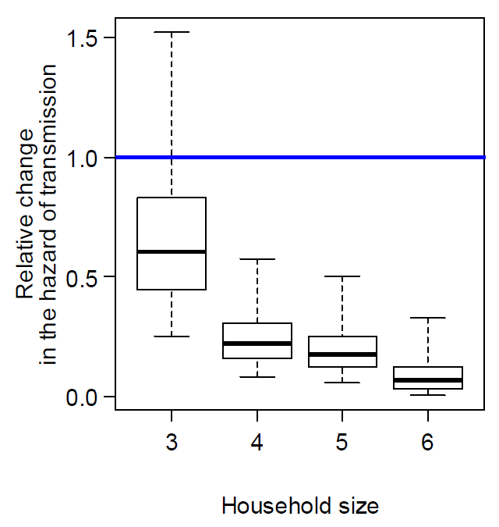
Transmission rates as a function of household size
β/n^{γ} ; γ=2.5[1.5,3.8]
Reference: size 2

Slide 33
How do transmission rates change with population size?
Model 1: p-to-p transmission rate doesn’t change with household size
β
β
β
β
β
β
Model 2: p-to-p transmission rate decreases with household size
People partition their time between household members
β
β/2
β/3
β/3
β/2
β/3

Slide 34
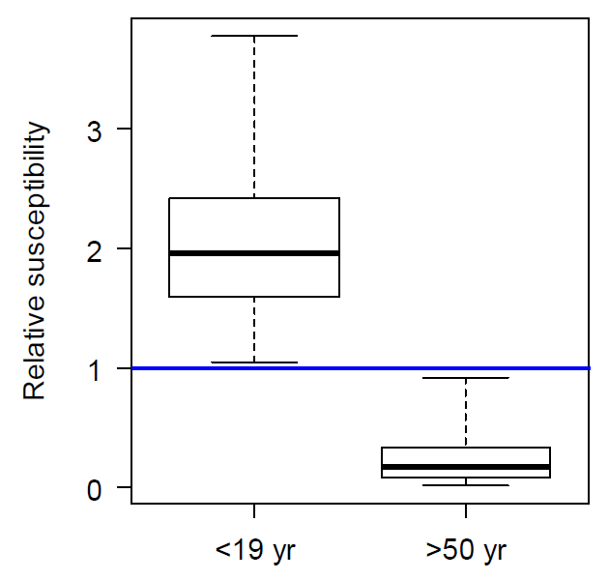
Age-specific susceptibility
Children (<19 yr): 1.96 [1.05,3.78]
>50 yr: 0.17 [0.02,0.92]
Reference group: 19-50 yr

Slide 35
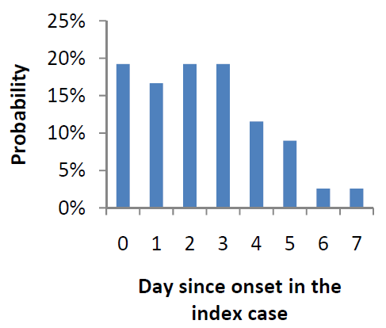
Serial interval
Observed time interval between onset in the index case & onset in household contacts
Estimated serial interval (correcting for tertiary infections, community infections, coprimary cases, censoring)
Day since onset in a case
Mean including co-primary cases: 2.4 days
Mean excluding co-primary cases: 2.9 days
Mean: 2.6[2.2,3.5] days
SD: 1.3[0.9,2.4] days

Slide 36
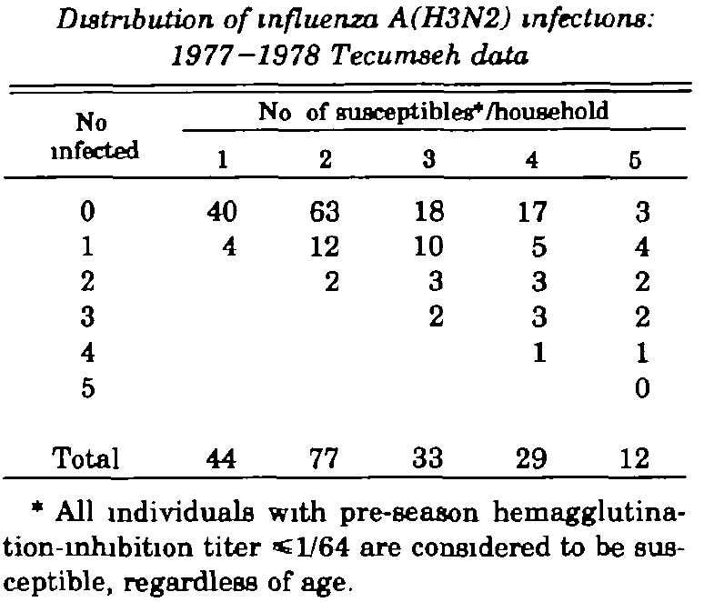
Measuring transmission in/out of households - final size data
Blood samples collected in household members before/after influenza epidemic
Infection defined as 4 fold increase in antibody titers
[Longini et al, AJE, 1982]

Slide 37
Models for household final size (1)
Parameters:
B: Probability to escape infection from community
Q: Probability to escape infection from infected household contact
What is the probability p_{jk} to observe j cases in a household of size k?
Households of size 1:
Households of size 2:
One is infected outside
The other one is not infected
[Longini et al, AJE, 1982]

Slide 38
Models for household final size (2)
General formula for a household of size k
Iterative procedure;
Assume that p_{jl} has been computed for households of size l<k;
Probability p_{jk} for j cases in a household of size k:
for j<k
Choose j individuals among k
Proba that the j individuals become cases
Proba that the k-j other individuals do not become cases
[Longini et al, AJE, 1982]

Slide 39
Likelihood-based inference
Data: table {m_{jk}} households of size k with j cases
The likelihood is the probability of the data given B,Q:
Maximum-likelihood:
Find the set of parameters {B,Q} that maximizes the likelihood function.
Model – given {B,Q}, gives the probability table {p_{jk}} to observe j cases in a household of size k

Slide 40
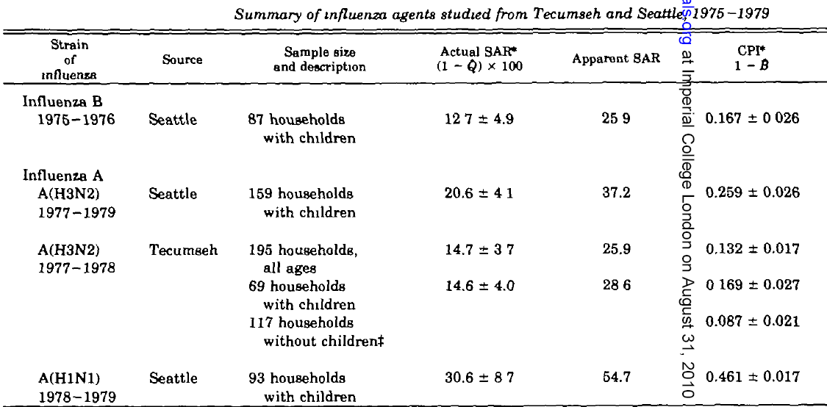
Estimates
[Longini et al, AJE, 1982]

Slide 41
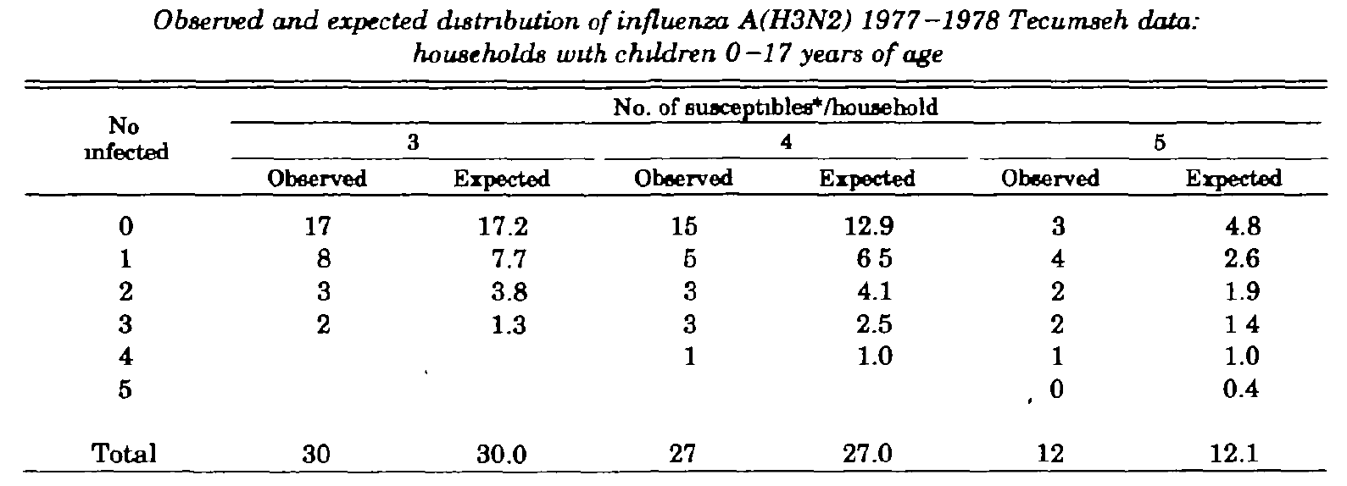
Observed-Expected
[Longini et al, AJE, 1982]

Slide 42
Summary
Statistical challenges:
Selection bias – e.g. large outbreaks are more likely to be investigated;
Reporting bias – e.g. children are often more likely to be detected;
Multiple possible sources of infection – e.g. secondary, community or tertiary case in an household?
Truncated/Censored data – e.g. follow-up of households stops after 1 week.
Households are a “laboratory” to study transmission:
Less affected by selection bias than e.g. investigations in schools;
Reproducible experiment – we know how to do it;
Important source to better understand/quantify spread.
Fitting models to data & estimating parameters from data:
Fundamental aspect of modelling! – Models need to be fed with data...
But analysis of data is also greatly enhanced by modelling:
Specific tools required to address challenges in the data (community cases etc...)
Standard statistical procedures are not necessarily most appropriate model;
Need to be able to build a statistical model to address your problem - very general methodologies:
Building a model;
Writing down the likelihood;
Maximizing the likelihood or doing Bayesian inference via MCMC.

